Slide 1
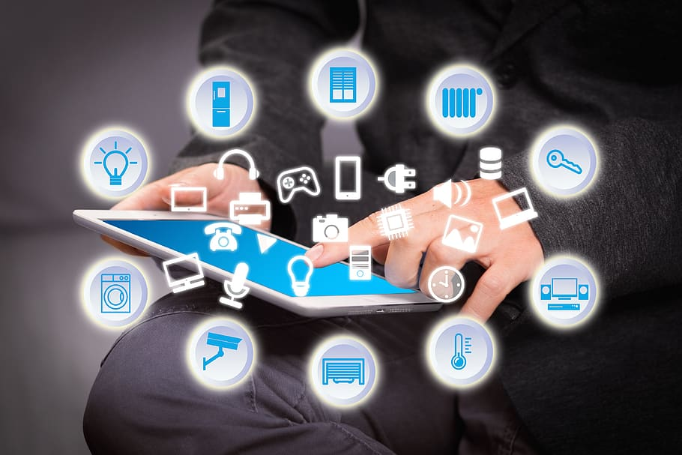
SELF – STUDY AND PRESENTATION
MOBILE
COMPUTING
Supervised by Brainwave Data Co, Ltd.
Presented by Tech King

Slide 2
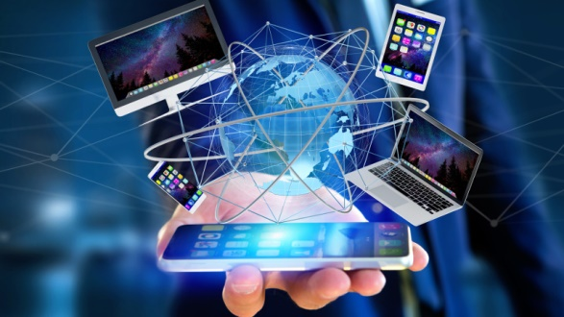
“ Mobile Computing “
Mobile : moved easily from one place to another - with wireless connectivity technologies such as Wi-Fi, Bluetooth, and cellular networks, users to access the internet, communicate with others, to work, communicate, and access information on the go.
Computing : computers and computer-related technology to process, store, and manage information, designing and building computer hardware and software, developing algorithms and programming languages, and using computers and software to solve problems and complete tasks.
Mobile Computing : to transmit data from one device to another device (smartphones, tablets, laptops, E-reader, Wearable Devices, Handheld gaming devices) by using Wi-Fi, cellular data networks, Bluetooth without any use of physical cables.
Disadvantages : Limited battery life, Security Risks, Limited screen size, Connectivity issues, Physical durability

Slide 3
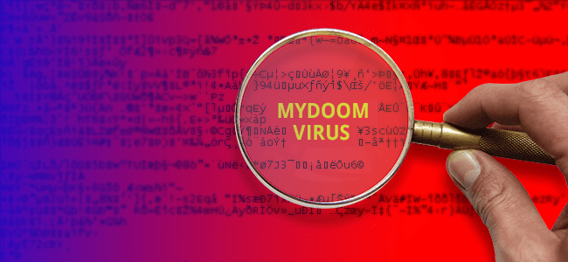


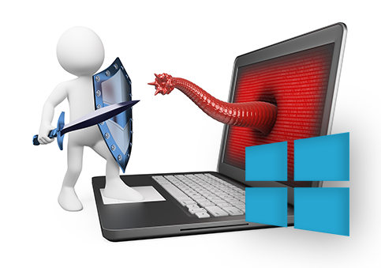





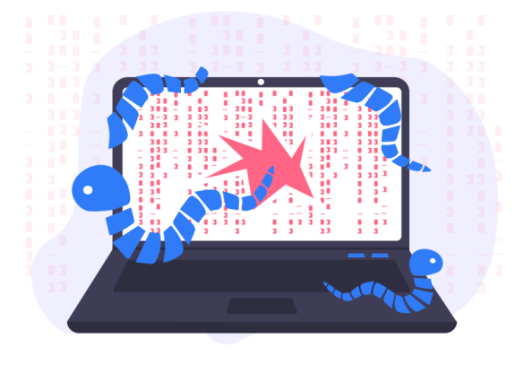
Security Risks : ( ILOVEYOU, Melissa, Code Red, Conficker, WannaCry, Stuxnet,
Mydoom, Zeus, Cryptolocker, Storm Worm )
Email, internet traffic
Billions of dollar
computer
Financial
Computer, ransomware
Email server, network
Financial
Web server
Nuclear program
Computer

Slide 4
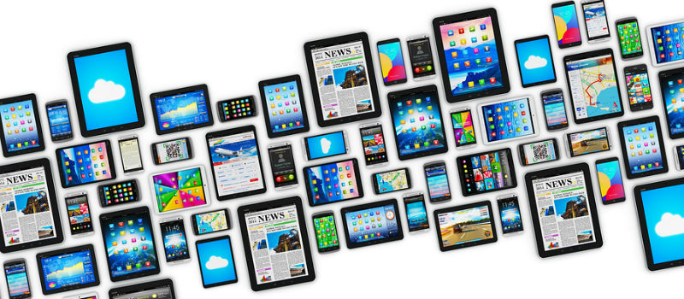

Portable Computing : ability to move a computing device from one location to another easily.
Mobility Computing : ability to access computing resources from anywhere using a mobile device such as a smartphone or tablet.

Slide 5
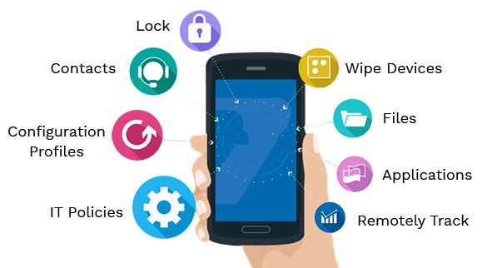
Mobile Computing Concepts :
Wireless communication
Mobility
Context-awareness
Mobile operating systems :
Mobile applications
Mobile security
Mobile device management
Cloud computing
4. Mobile Operating System
2 Functions of OS
2.1 1. Memory Management
2.2 2. Processor Management/Scheduling
2.3 3. Device Management
2.4 4. File Management
2.5 5. Security
3 Types of Popular Mobile Operating System
3.1 1. Android OS
3.2 2. Bada
3.3 3. Blackberry OS
3.4 4. Apple iOS
4 Features of Mobile Operating System
4.1 1. Easy to use
4.2 2. Good app store
4.3 3. Good battery life
4.4 4. Data usage and organization
5 Components of a Mobile Operating System
5.1 1. Kernel
5.2 2. Process Execution
5.3 3. Interrupt
5.4 4. Memory Management
5.5 5. Multitasking
5.6 6. Security
5.7 7. User Interface

Slide 6
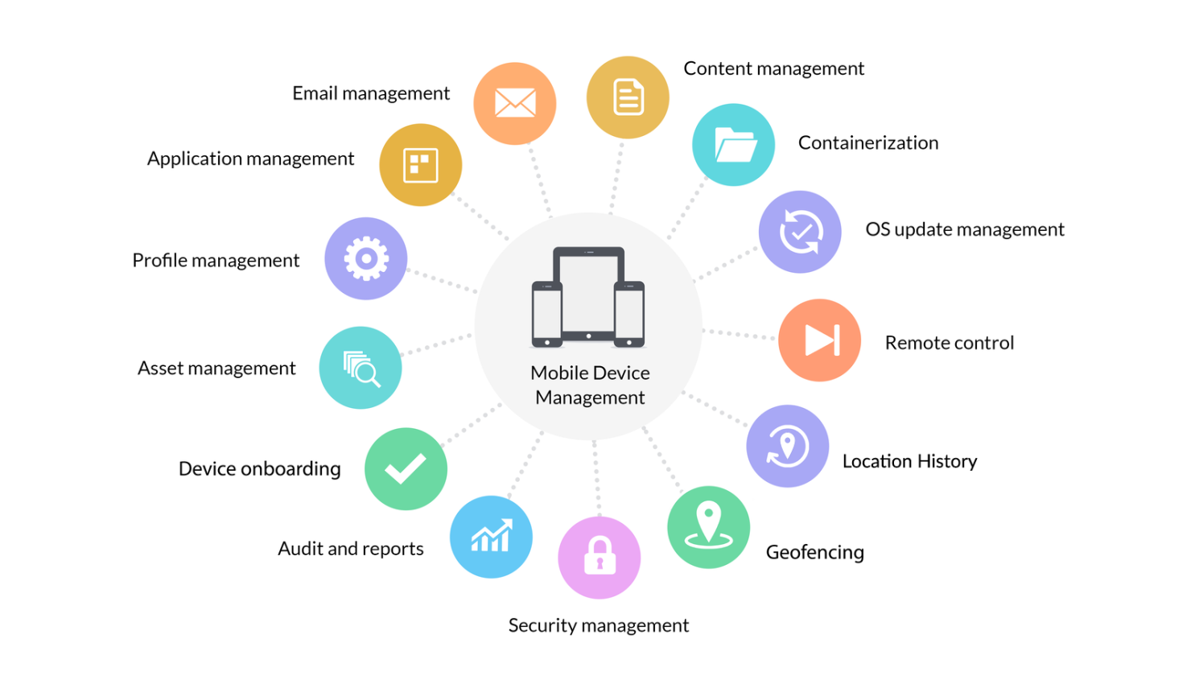
Mobile Computing Methodologies :
Responsive design : user's device and display the content in an appropriate format.
Native app development : mobile platform, such as iOS or Android
Hybrid app development : web app + native app
Mobile web development : developing mobile-friendly websites
Mobile cloud computing : accessed from anywhere, using any device
Mobile device management : mobile device management (MDM) | mobile
application management (MAM).
7. User-centered design : designing applications and services |context, location, and
device capabilities.

Slide 7
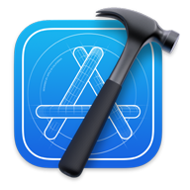

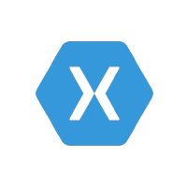





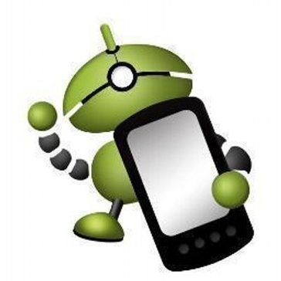

Mobile Computing Tools :
1. Integrated development environments (IDEs) : development environment for
building mobile application | Android Studio for Android app development and Xcode
for iOS app development.
2. Cross-platform development tools : to build mobile applications that can run on
multiple platforms, such as Xamarin and Unity.
3. Mobile app frameworks : libraries of pre-built code | include React Native, Ionic, and Flutter.
4. Mobile testing tools : to test their mobile applications on real devices or emulators to identify bugs | include Appium, Robotium, and Selendroid.

Slide 8

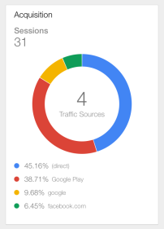

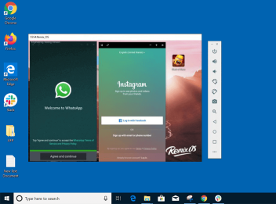

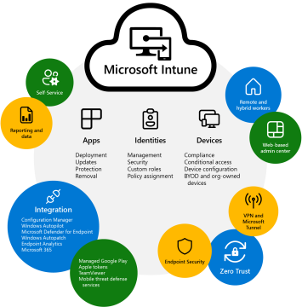

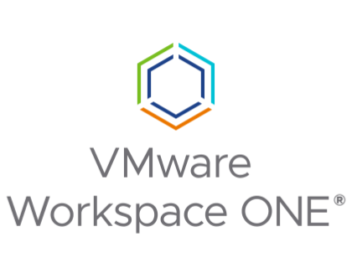
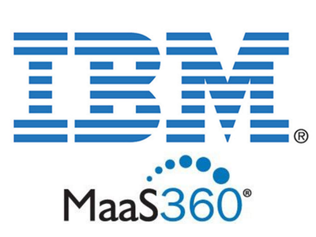
5. Mobile analytics tools : insights into how users are interacting with the mobile application, including usage statistics, user demographics | include Google Analytics for Mobile Apps, Flurry Analytics, and Mixpanel.
6. Mobile device emulators : debug their mobile applications without needing a physical device | include Android Emulator and iOS Simulator.
7. Mobile device management (MDM) software : device configuration, app distribution, and remote wipe capabilities | include Microsoft Intune, VMware Workspace ONE, and IBM MaaS360.

Slide 9
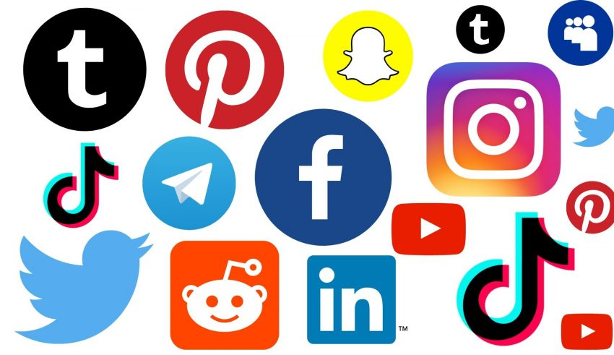
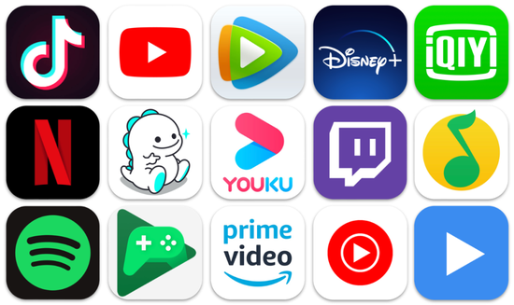
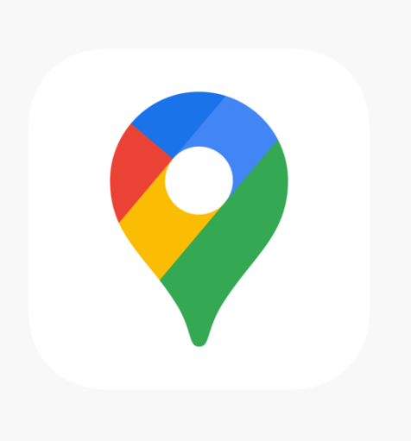
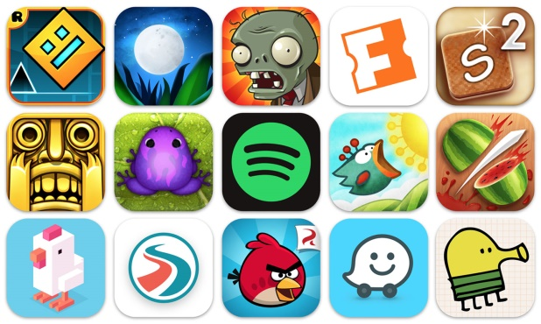
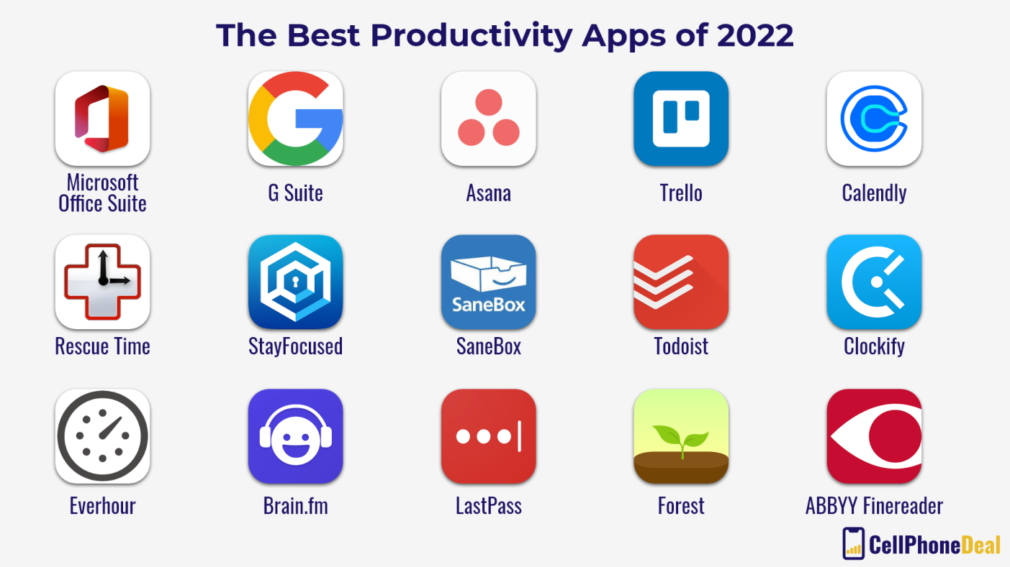
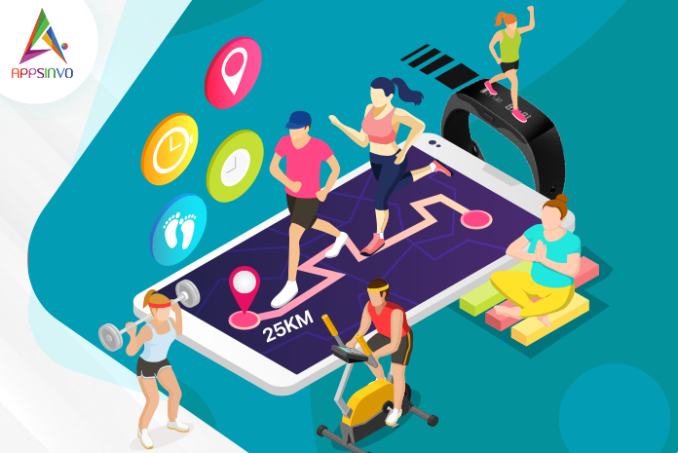
Mobile Computing Applications :
Social networking apps
Entertainment apps
Gaming apps
Productivity apps
Enterprise apps
Navigation and mapping apps
Health and fitness apps

Slide 10

T
H
A
N
K
YOU
B
Y
T
E
C
H
KING

